Slide 1

Sharnbasva University Kalaburagi
Project Title: “FAKE CURRENCY DETECTION USING MACHINE LEARNING”
Performed By :
Abishek Datta Jagtap
(SG21MCA002)
Under the Guidance of:
Dr. Shrikanth Patil

Slide 2
1. INTRODUCTION
Abstract
Fake bank currency poses a significant threat to our country's financial system.
During demonetization, a large amount of counterfeit money was found in circulation.
Distinguishing fake notes from genuine ones is challenging due to their similarity.
An automated system using machine learning can aid in identifying forged bank currency efficiently.
Six supervised machine learning algorithms can be used for banknote authentication.
The algorithms employed are: K-Nearest Neighbors (KNN), Decision Tree, Support Vector Machine (SVM), Random Forest, Logistic Regression, and Naive Bayes.
Additionally, the LightGBM algorithm can also be used.

Slide 3
Introduction
In our fast-paced financial world, banknotes play a critical role as a valuable asset of our country.
However, counterfeit notes are being introduced into the market, closely resembling genuine ones, causing financial discrepancies.
Human detection of forged bank currency is difficult due to the high precision with which fraudsters create fake notes.
Government-designed features on banknotes help identify genuine ones, but counterfeiters mimic these features with great accuracy.
To combat this problem, an automated system using machine learning can be implemented in banks and ATMs.
The goal is to design an automated system to determine the legitimacy of banknotes.
By inputting the physical features of the banknote and applying various machine learning techniques, relevant features are extracted.
These features are then fed into SML algorithms to predict whether the note is genuine or fake.

Slide 4
Problem Statement
Developing an automated system using machine learning to detect counterfeit banknotes from genuine ones, addressing the rising concern of fake currency in the financial market.

Slide 5
Aim of the Project
Create an automated system to combat the rising prevalence of counterfeit banknotes in the financial market.
Leverage machine learning algorithms to accurately identify forged banknotes based on their distinctive features.
Safeguard the economy by ensuring the authenticity of monetary transactions and protecting businesses and individuals from financial losses due to counterfeit currency.

Slide 6
Objectives
To build the model with maximum accuracy using the appropriate Machine learning algorithms.
To save the final built model.
Design web pages using HTML and CSS
Expose the web pages using Django framework

Slide 7
Limitations
Complex feature engineering.
High computational complexity.
Imbalanced data affecting performance.
Scalability challenges with large datasets.
Generalization may be impacted by limited or biased training data.
Dependence on well-generalized data.

Slide 8
2. SYSTEM ANALYSIS
Existing System
Supervised machine learning (SML) is widely used for classification problems, showing promising results in medical disease detection.
Limited research has been done applying SML algorithms to bank currency authentication.
To detect genuine or fake banknotes, an automated system is necessary.
The system takes an image of the banknote as input and extracts features using image processing techniques.
SML algorithms are then employed to predict whether the note is authentic or counterfeit.
Notably, there is a gap in the research on this subject, indicating an opportunity for further exploration and development.

Slide 9
Proposed System
The proposed system utilized several popular algorithms, including KNN, Decision Tree, SVM, Random Forest, Logistic Regression, and Naive Bayes.
Additionally, the LightGBM algorithm was introduced as an extension to the existing set of algorithms.
The performance of LightGBM was compared against the other algorithms used in the study.
This comparison aimed to assess the effectiveness and efficiency of LightGBM for bank currency authentication.
The inclusion of LightGBM expands the scope of the research and allows for a more comprehensive evaluation of different machine learning approaches.

Slide 10
Literature Survey
D. Alekhya, G. D. Surya Prabha and G. V Durga Rao, "Fake currency detection using image processing and other standard methods", IJRCCT, vol. 3, no. 1, pp. 128-131, 2014.
M. Thakur and A. Kaur, "Various fake currency detection techniques", International Journal for Technological Research in Engineering, vol. 1, no. 11, pp. 1309-1313, 2014.
S. Jadhav and R Khanai, "Authentication and Counterfeit Detection of Currency Using Image Processing", In International Conference on Recent Innovations in Engineering and Management (ICRIEM-16), pp. 709-715, 2016.
R Sneha, P K Deepika, S Nagaveni, D Swetha Shree and K S. Asha, "Automatic counterfeit currency detection using Image Processing", International Research Journal of Engineering and Technology (IRJET), vol. 4, no.5, 2017.
Eshita Pilania and Bhavika Arora, "Recognition of Fake Currency Based on Security Thread Feature of Currency", International Journal of Engineering and Computer Science, vol. 5, pp. 1713617140, 2016.

Slide 11
Feasibility Study
Operational Feasibility
The proposed system should seamlessly integrate with existing bank and ATM operations.
Adequate resources, technical expertise, and support must be available for implementation and maintenance.
End-users, such as bank staff and customers, should be willing to adopt and utilize the system effectively.
The system should comply with legal and regulatory requirements.
Scalability and future growth considerations should be taken into account for sustained performance.

Slide 12
Technical Feasibility
The purpose of this study is to assess the technical feasibility of the system.
The system must not impose a high demand on the available technical resources.
High demands on the technical resources may lead to an excessive burden on the client.
The developed system should have modest resource requirements, necessitating minimal or no changes for implementation.
Economic Feasibility
The purpose of this study is to assess the economic impact of the system on the organization.
This project is developed with a limited budget for research and development of the system, so expenditures must be justified.
The developed system is within the allocated budget, primarily due to the utilization of freely available technologies.

Slide 13
3. SYSTEM ENVIRONMENT
HARDWARE REQUIREMENTS
Processor : minimum intel i3
RAM : minimum 4GB
Hard disk : minimum 250GB
SOFTWARE REQUIREMENTS
Operating system : Windows 10
Technology : Python 3.0 version, Visual Studio
Framework : Django

Slide 14
4. MODULES
Login
Allows users to authenticate and access the system securely.
Provides user-specific access to the functionalities of the application.
Upload Dataset
Enables users to upload datasets from local storage or external sources.
Validates the format and size of the uploaded data before processing.
Preprocess Dataset
Performs data cleaning, normalization, and transformation on the uploaded dataset.
Handles missing values and prepares the data for training machine learning models.

Slide 15
Train ML Algorithms
Trains machine learning algorithms using the preprocessed dataset.
Evaluates and selects the best-performing algorithm for Fake Currency Detection.
Fake Currency Detection:
Utilizes the trained ML model to detect fake currency from given input data.
Generates prediction results and provides insights on currency authenticity.
Logout:
Allows users to securely log out from the system and terminate their session.
Ensures the protection of user data and privacy.

Slide 16
5. SYSTEM DESIGN
Data Flow Diagram (DFD)
Start
Login
Upload Dataset
Preprocess Dataset
Train ML Algorithms
Evaluate Models
Logout
Display Result
Fake Currency Detection
Select Best Model
End

Slide 17
ER Diagram
Login_rol_id
Username
Password
Username
User_id
User_id
Login
User_Name
Password
Has access
User
Admin
Password
Email
Email
Manage
Input Values
Test Data
Train Data
Algorithms
Validations
id
Test Data
Prediction

Slide 18
Use Case Diagram
Data Collection
Data Preprocessing
Feature Extraction
Build Model
Comparison Graph
Load Model
Sign up & Sign In
Upload Test Data
Predict Genuine or Fake result

Slide 19
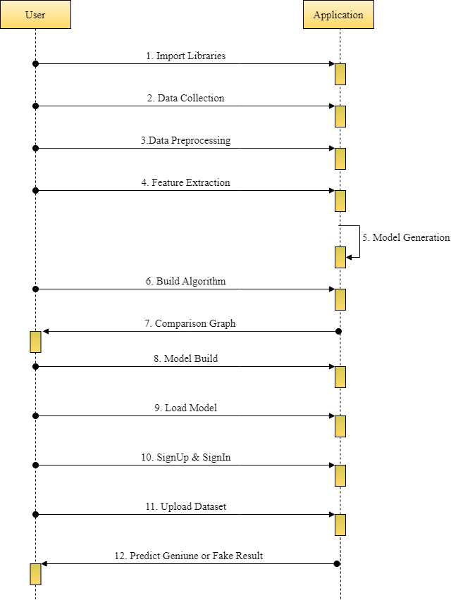
Sequence Diagram

Slide 20
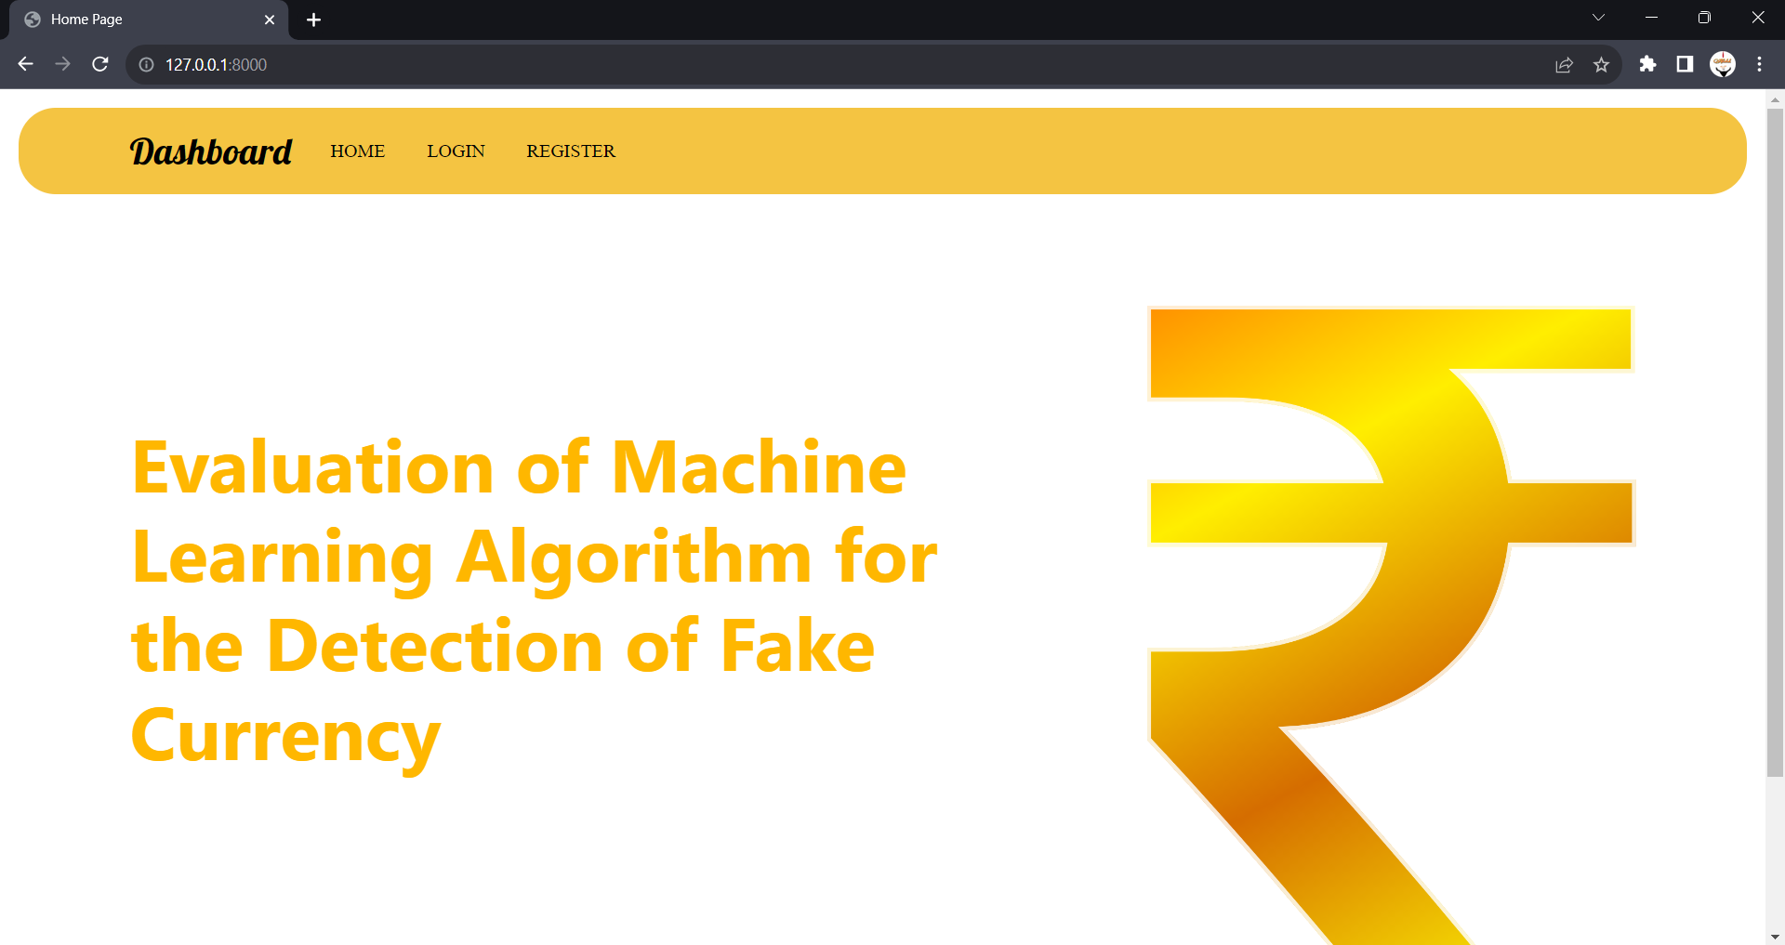
6. FORM DESIGN
HOME

Slide 21
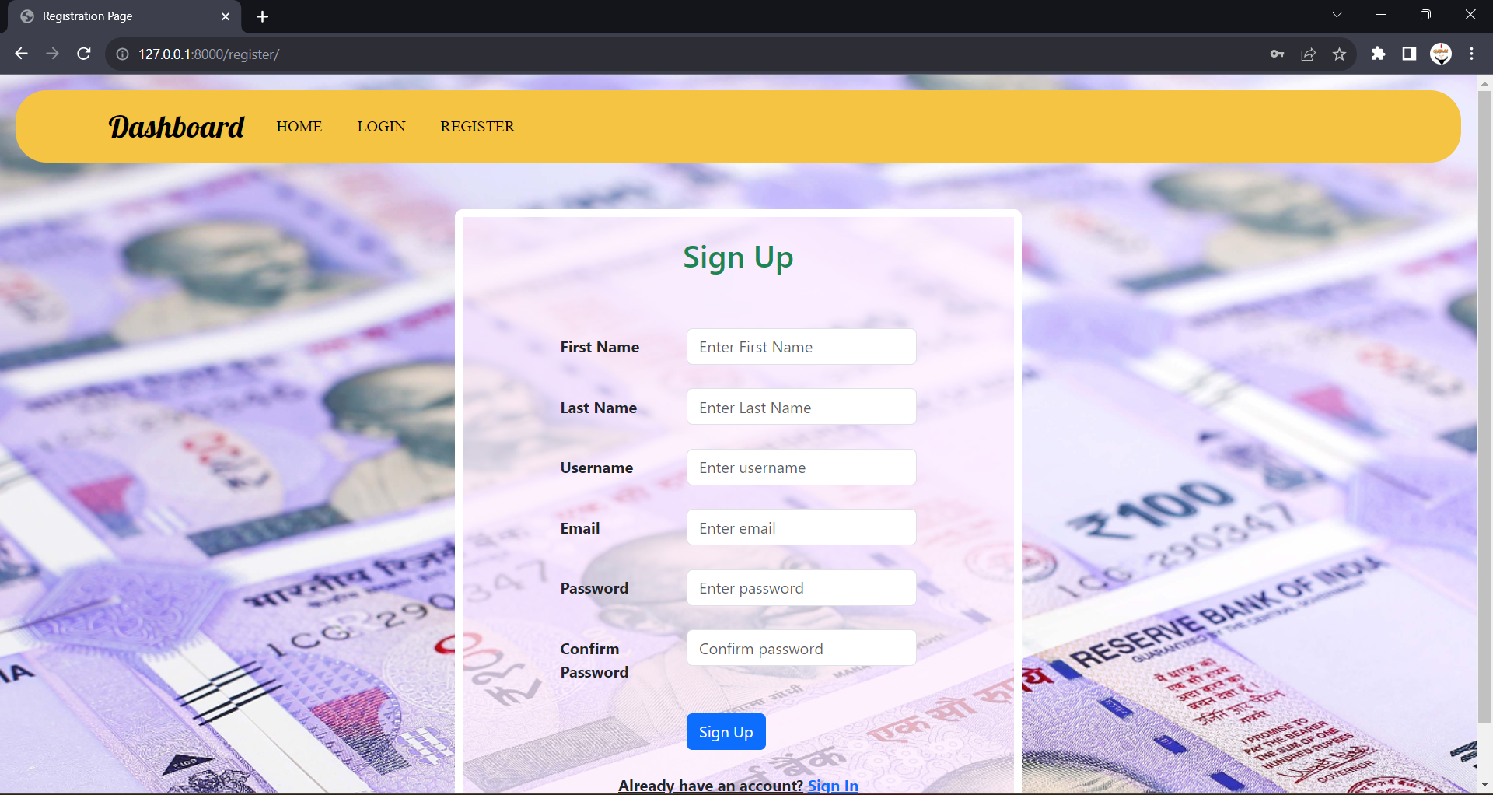
Registration Page

Slide 22
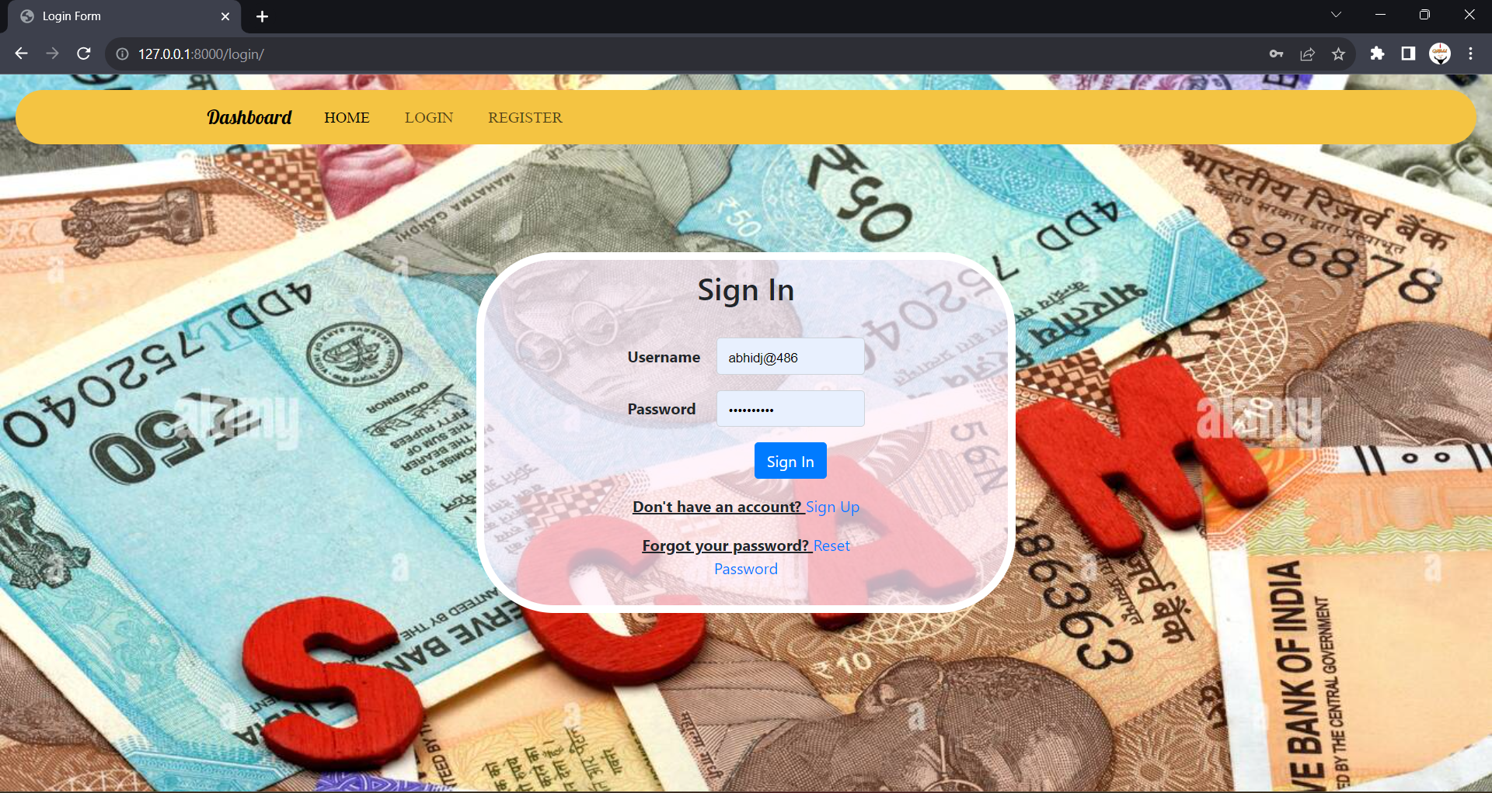
Login Page

Slide 23

User Home Page

Slide 24
Thank You

